Slide 1
The Effects of Social Media on the Formation of Self Insulating Communities
Matthew Meigel

Slide 2
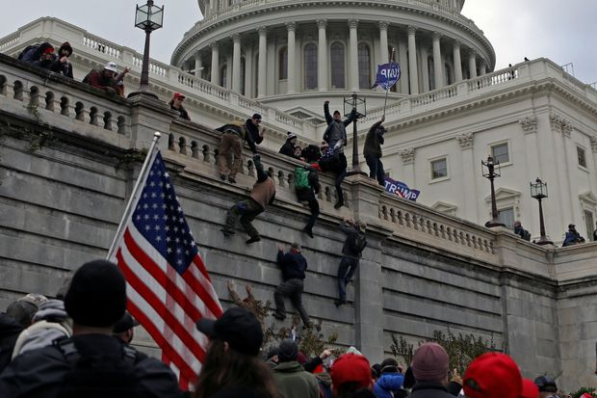
Our modern connectedness has allowed people from across the world to collect and cooperate with ease. However, the ways in which we connect have increased the ability to create isolated and self-insulating communities creates a dangerous possibility for radical action, such as with the capitol riots and their involvement with the “Qanon Cult” which is comparable to historic examples such as the Know Nothing Movement, and the Anti-Masonic Party. These communities are similar in thought and intent with many parallels between them, I’m seeking to uncover how Social Media particularly through moderation can be used to create echo chambers of radical thought

Slide 3
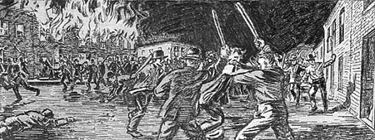
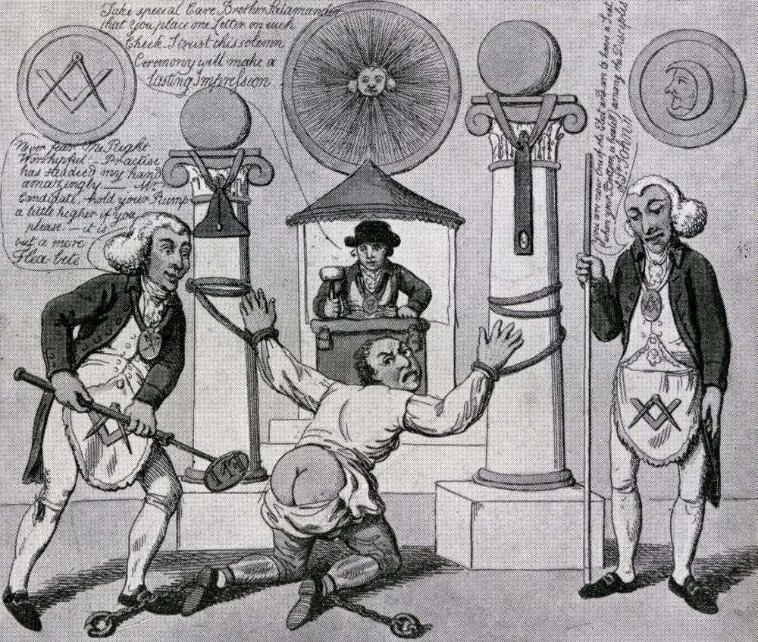
Who are these communities?
Depiction of the “Bloody Monday” Riots
Historical Cases
Know-Nothing Party/Movement- A secret society that grew into a political party, focused on anti-catholic, anti-immigrant and xenophobic policies. They were implicated in multiple riots the worst of which came to be known as “Bloody Monday” causing 22 deaths during a hotly contested race for the office of governor over claims of non-citizen flooding the polls. They had also incited violence at multiple elections between 1856-1858 over accusations of ballot rigging, including the tarring and feathering of a Catholic priest and the burning of a Catholic Church.
Anti-Masonic Party- Created out of conspiracy fear of the Mason Secret Society, while firstly emerging as a single issue political group they gathered others who were discontent with political conditions and expanded their platform. Their party was deeply committed to conspiracy claims that Masonic elites were attempting to control the government and favored direct appeals to the public through rallies, parades and party nominated news papers
Current Study
Qanon- An online conspiracy community focusing on the presidency of donald trump, the group has strong religious implications and has adopted a cult-like status. The group is led by “Q” who is responsible for the organization's radical beliefs as they continuously cultivated and informed the community through many online platforms such as Reddit, Parler and Facebook. On January 6th 2021 members of their organization stormed the US capitol building leading to 5 deaths.
“How to make a Mason” Anti-Mason Caricature

Slide 4
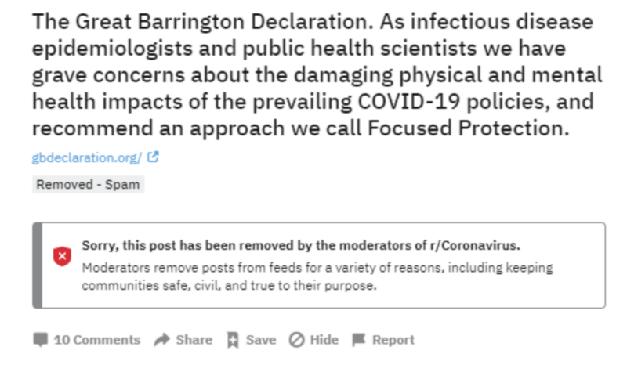
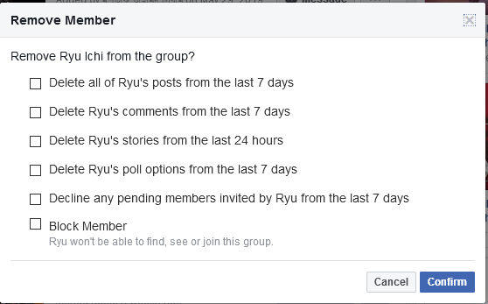
Social Media outsources Moderation to Users Directly
How does Social media affect the ability to create communities that can be moderated or censored to promote radical ideas while allowing their members to collect and convene anonymously. How does it allow these organizations to form, organize to take radical action, and to continuously thrive even when implicated in controversy. Websites such as Reddit, Parler, Facebook and even Discord allow users to create communities they can personally moderate, controlling who can talk, what can be said, and often even the ability to remove content.
This moderation is not subject to review and allows the creation and control of communities who lack diversity of thought. With so many like minded people, it perpetuates the ideas of the group, these self insulating communities grow unimpeded and the ideas of the members go unchallenged, furthering their beliefs.
Examples of Moderation from Reddit and Facebook

Slide 5
What are these platforms and how are they used?
Reddit- A platform based around forum communities called subreddits, these communities can be created by users and allow for moderation tools including deleting posts and comments, banning or restricting users from accessing or engaging with a community, or even creating private invite only communities.
Facebook- A large social media platform that allows users to collect and connect with others of similar interests, also allowing private messaging and moderated group chats where users have to be invited and can be removed at any time.
Parler- A microblogging website much like twitter, while it supposedly supports freedom of speech its controversial moderation of liberal and left wing users who have been banned for challenging opposing viewpoints is concerning. The site has also amassed a large base of Trump and Qanon supporters and played a role in planning and inciting the Capitol Riots.
Discord- A server based voice and messaging platform where any user can create a server and control every aspect of its moderation from who can talk or message and where, who can see what content or channels, the ability to delete messages and kick or ban users from the server and even allowing for file sharing between members.

Slide 6
Why this Research is Important
If we are able to understand what allows these organizations to thrive and expand we can be more informed in their actions and operations, while everybody has a right to collect and peacefully propagate change its clear that these groups are capable of real harm. During the Capitol Riots, hundreds of people from all across the country collected and organized online through websites such as Reddit, Parler, Facebook, and Discord and stormed the U.S. capitol building.
The possibility for a similar event which could even be more violent to occur is real and with hope my research can lessen that possibility. Importantly many of these platforms have taken action already, Twitter cracked down on misinformation, Discord banned more than 2000 extremist communities, and Facebook has banned or removed users over hate speech. However these communities thrive under the radar and although efforts to curb their growth are effective, an understanding of how they propagate beliefs will lead to greater more effective action in not only halting their growth but in intercepting their actions.

Slide 7
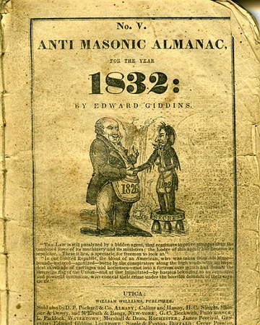
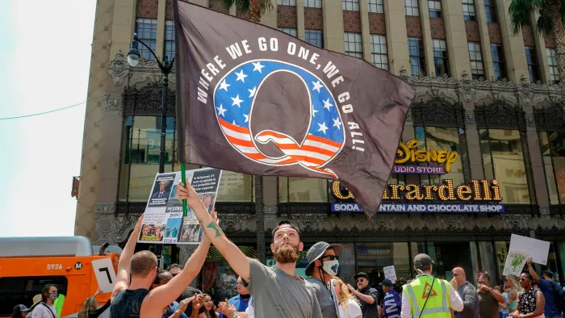
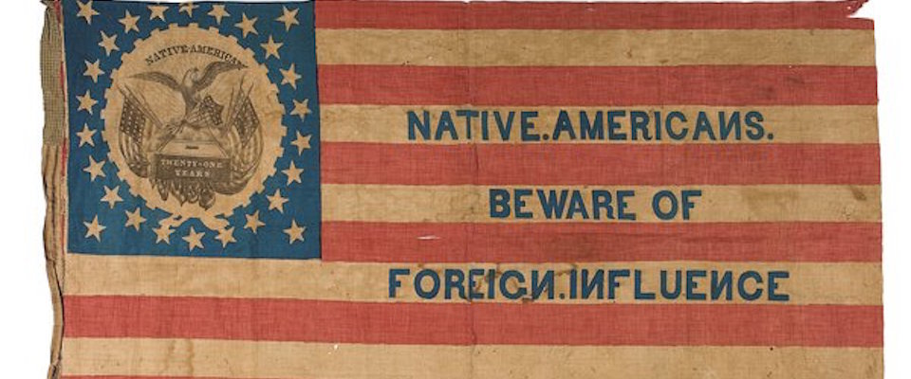
Research Plan: Comparative Insights from Similarly Self-Insulating Groups
I draw on information about similar U.S. groups such as the xenophobic Know-Nothing movement and the conspiracy born Anti-Masonic movement, to understand the roots of the modern phenomenon of the “Qanon Cult” which inherits characteristics of both previous movements to compare how the factors that led to the formation and popularity of these insulating organizations were further affected by modern social media within self insulating online communities. With this research I hope to be able to identify some red flags and early warning signs of these groups so that we have a better understanding of how these groups form which can help us create systems to dissuade people from joining them limiting their potential growth and to mitigate the harm they may cause.
Qanon Protestors
Know-Nothing Party Flag
Anti-Masonic Almanac
(Native Americans is not referring to Native American Tribal Members, rather referring to radical “Native Born” American Nationalists)

Slide 8
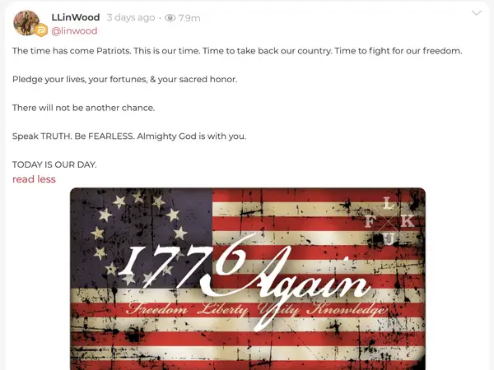
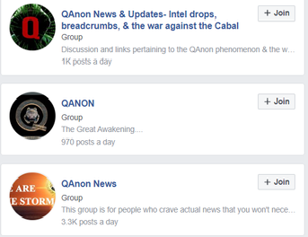
Regulating Standards and Moderation
Social media has become a powerful platform that we often take for granted, it allows us to reach people with our ideas far beyond what we could have ever imagined and it gives a powerful voice to groups that otherwise struggle to be heard. These platforms however are dangerous and as we have seen they have the potential to create violent situations and immense tension among a population or community. Our willingness to regulate and undertake PAID Moderation has not kept up with this threat.
Moderation has become too powerful of a tool on these platforms and while it may be used by the company to control their general communities, it is also afforded to users who create their own communities on these platforms. These communities such as Private Subreddits, Facebook Pages or Groups, and Discord Servers boast powerful moderation tools that can be used to censor large groups of people and the actions of these groups may go unchecked by the companies behind their platforms. This creates the perfect breeding ground for radical, dangerous or outright illegal communities who are afforded strong moderation tools as well as anonymity allowing them to create massive like minded, wide reaching and self insulating communities who can hide, reform, and react to attempts at moderation, observation, and intervention by outside forces.
Example of Twitter Crackdown on Misinformation
Parler post about the Capitol Riots
Qanon Facebook Groups

